Slide 1
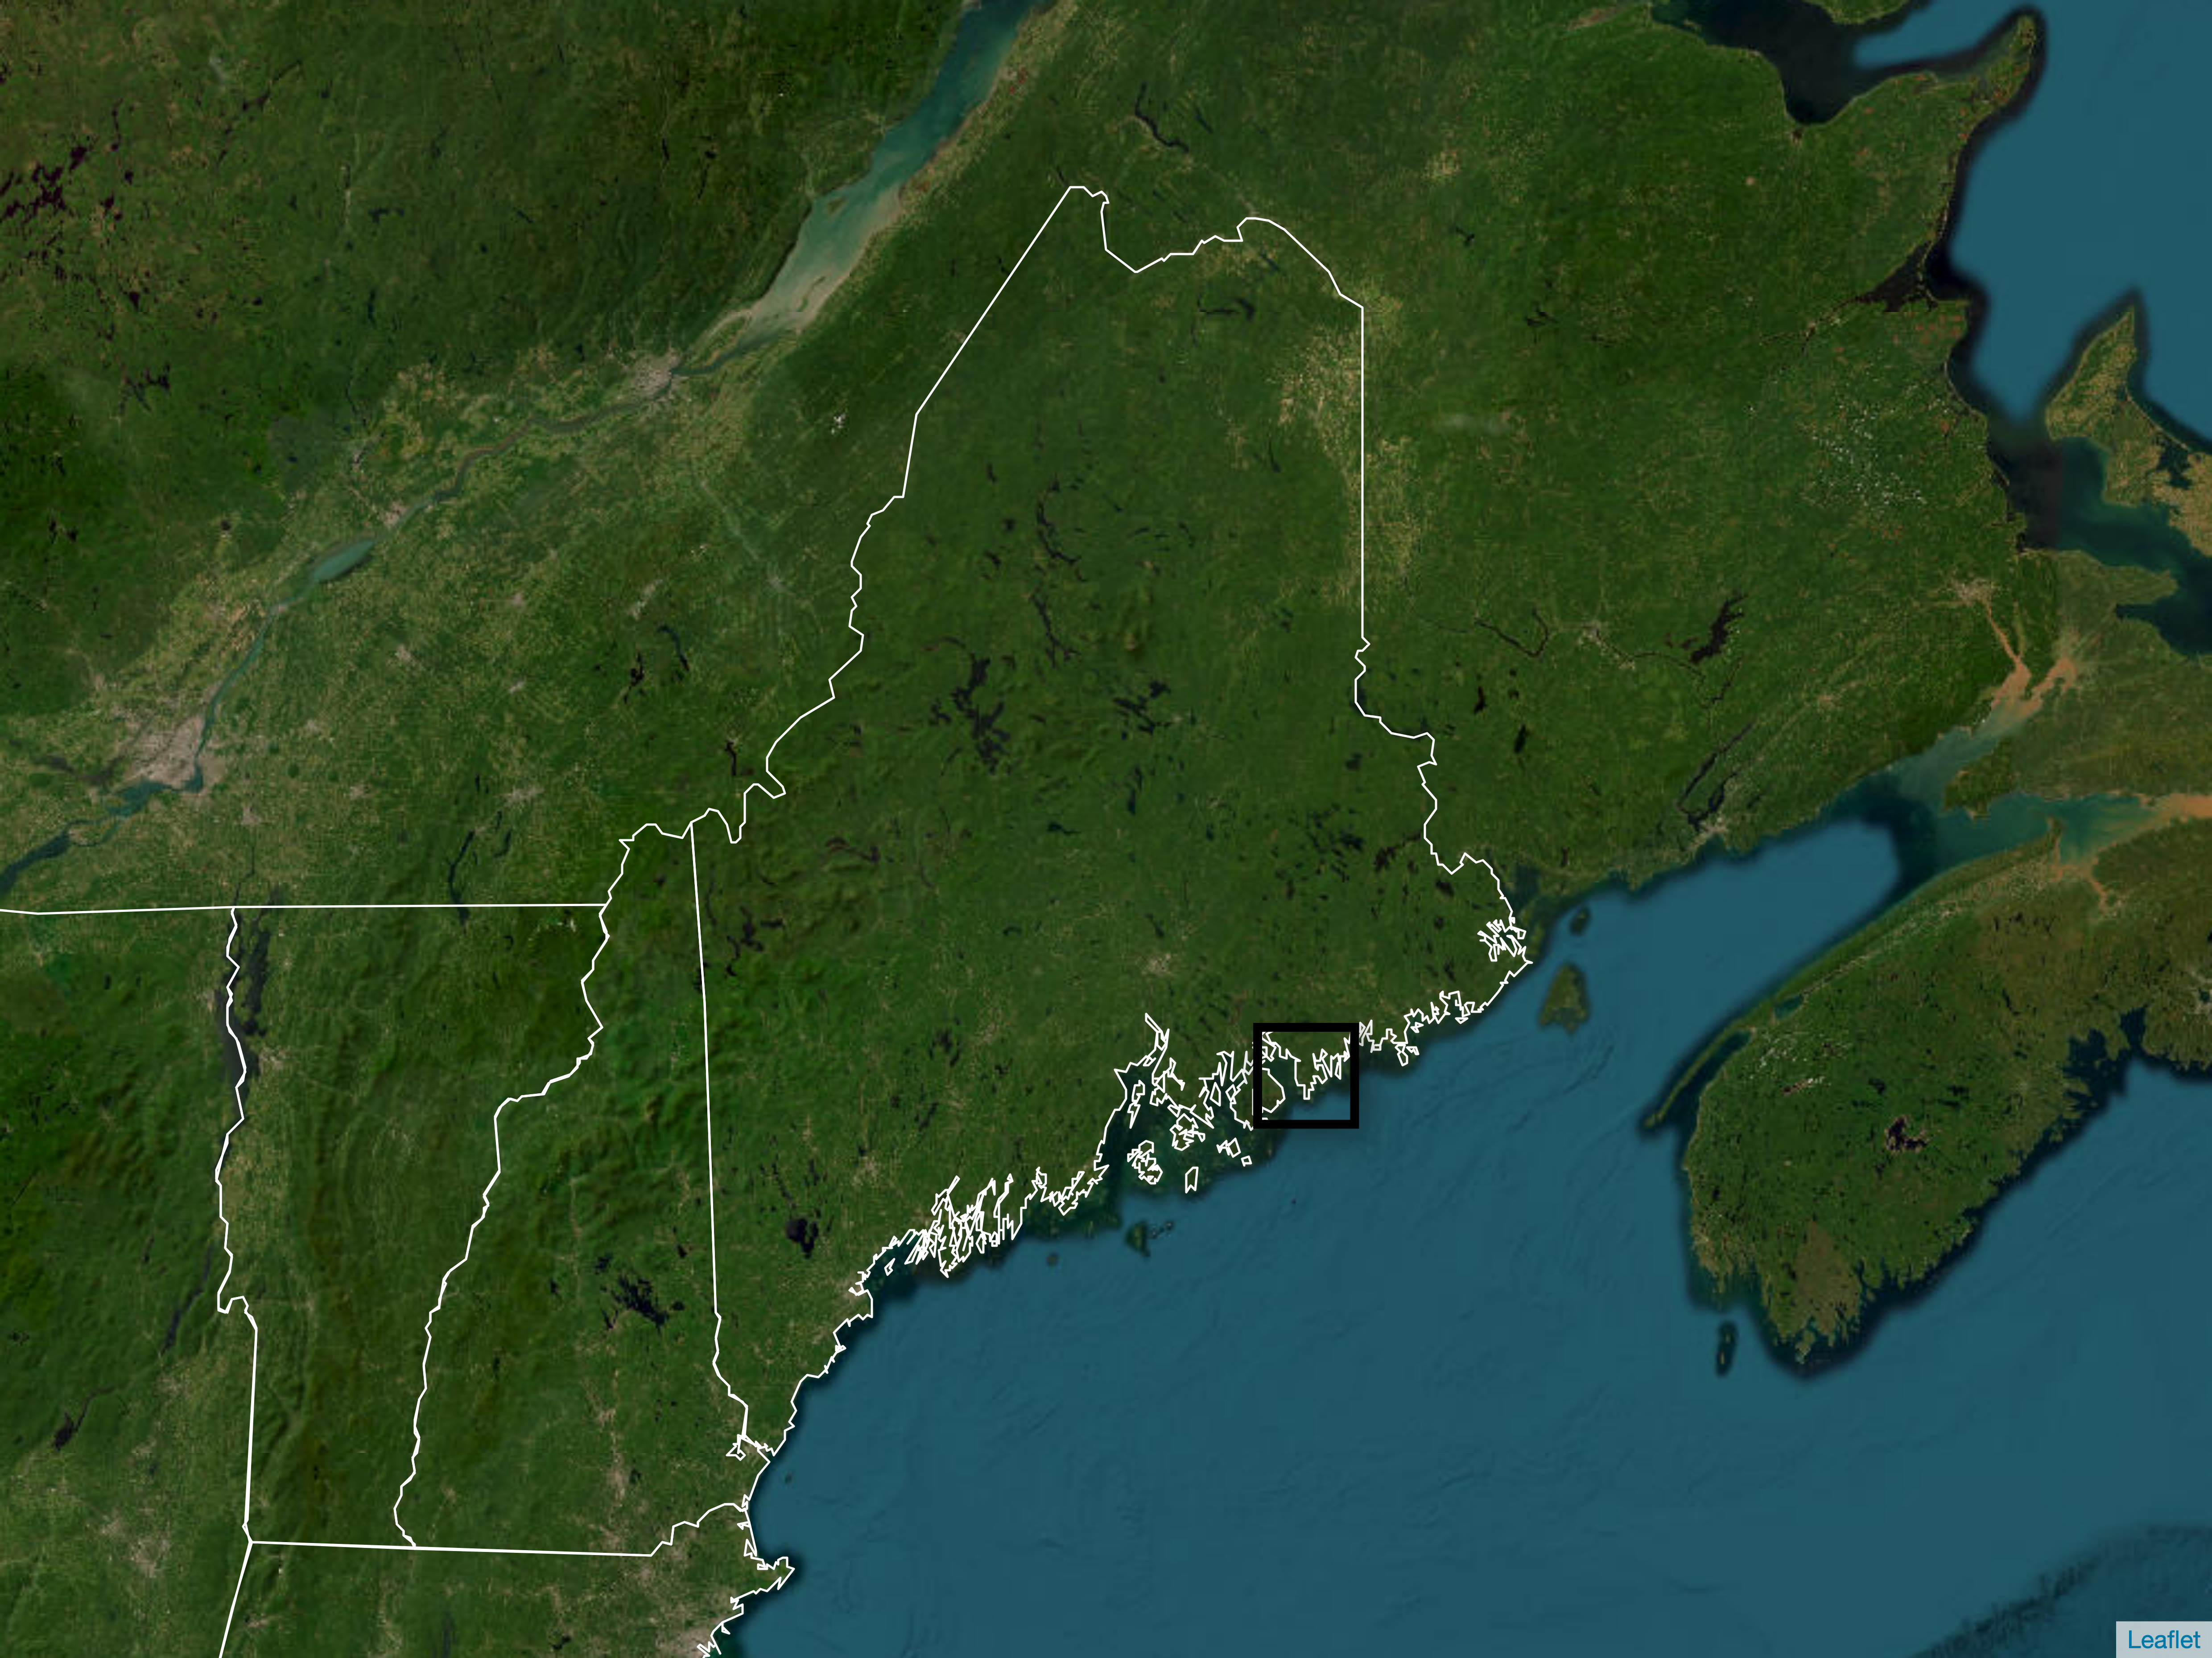
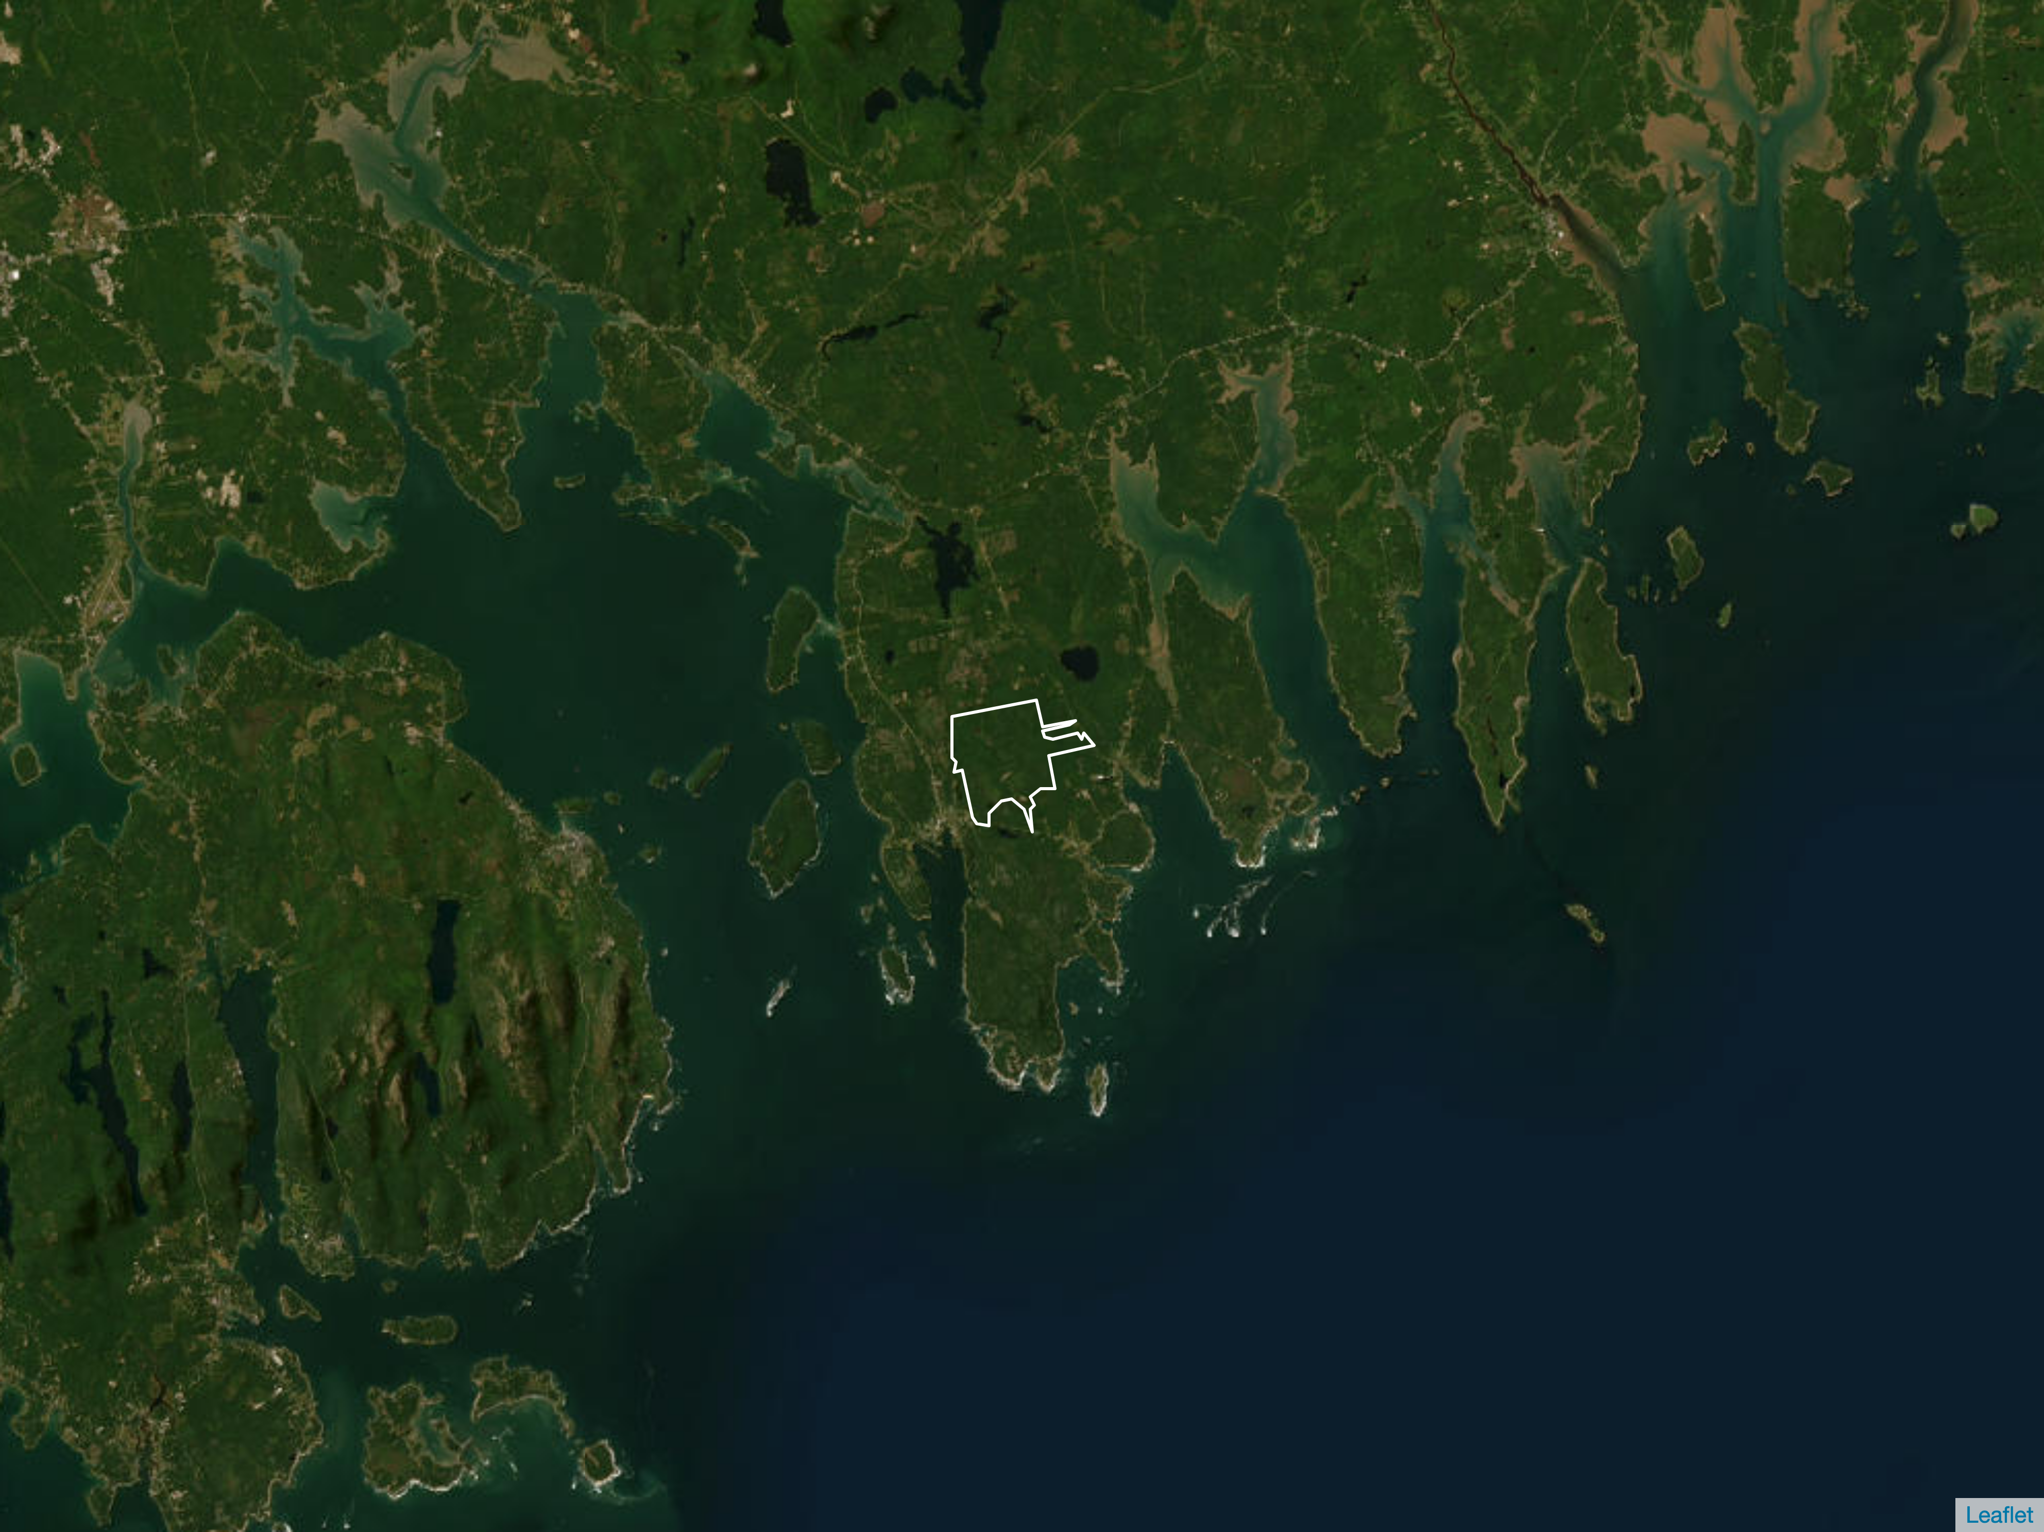

New Brunswick
Quebec
Maine
Bar Harbor
New Hampshire
Schoodic Forest
Vermont

Slide 2
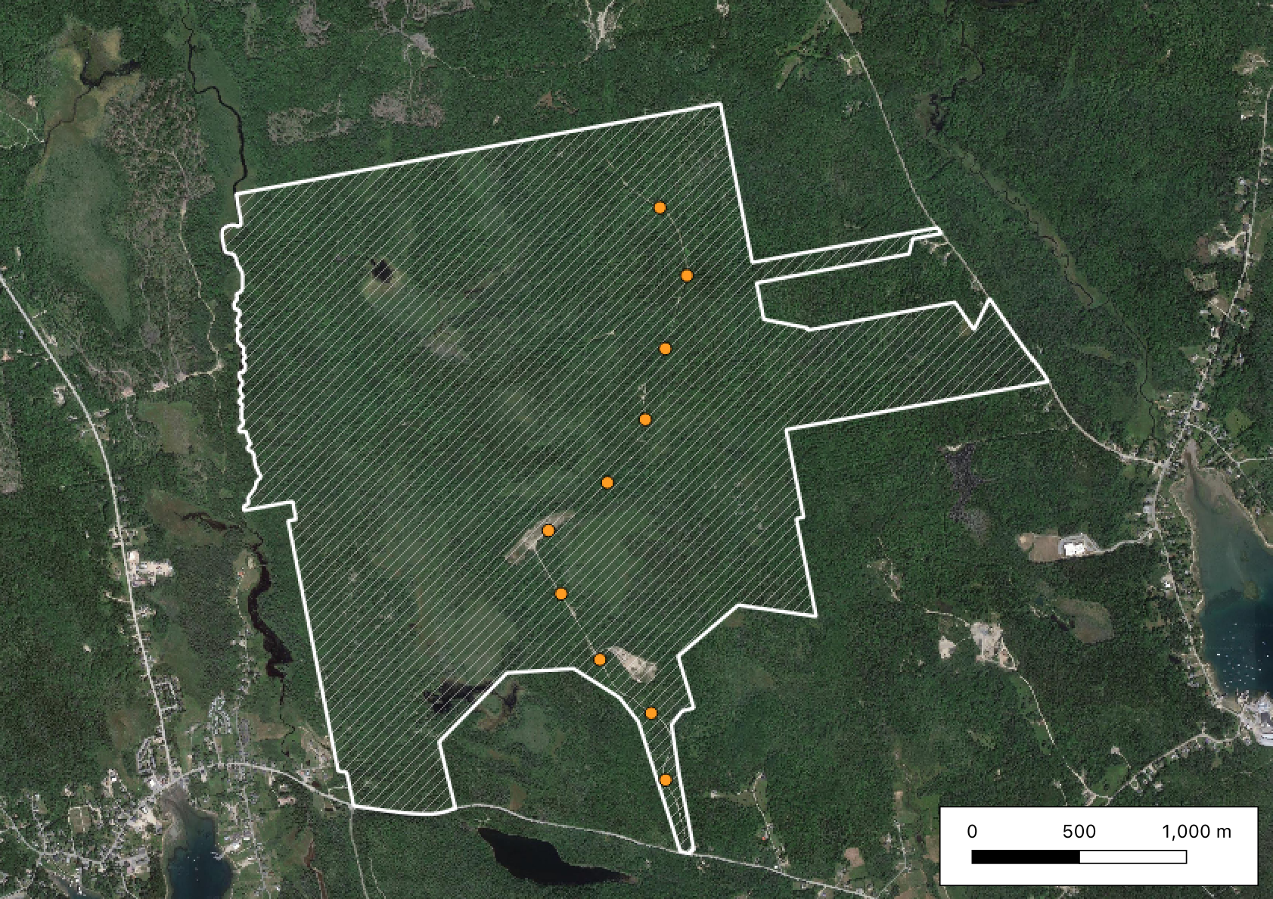
Schoodic Forest
Point-count sites
Site 10
500m
Site 1

